Slide 1
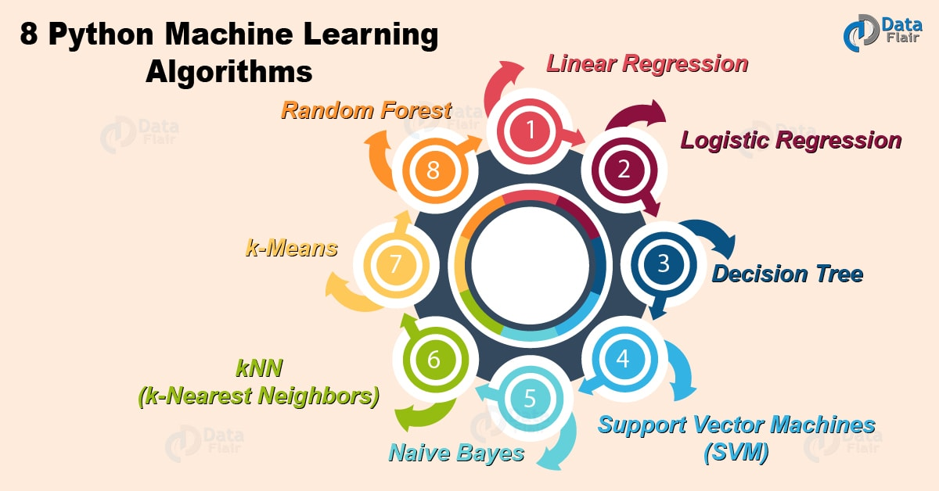
Classification Algorithms
An ANN is based on a collection of connected units called artificial neurons, which loosely model the neurons in a biological brain.
ANNs were first introduced by Pitts in 1943 who created computational model for NNs based on algorithms called threshold logic unit (TLU).
ANNs are powerful ML that can solve many complex problems.
Typical Algorithms:
Decision Trees
Logistic Regression
Artificial Neural Networks
K-Nearest Neighbor
Random Forests
Naïve Bayes
Support Vector Machines
What is a biological neuron? How does it function?
1
Notes:
Artificial neural networks, usually simply called neural networks, are computing systems ..
inspired by the biological neural networks that constitute animal and human brains
ANNs were widely used in the 80s, early 90s ; but popularity diminished in late 90s.
We will first cover the biological neurons and then learn how to emulate them
https://en.wikipedia.org/wiki/Artificial_neural_network

Slide 2
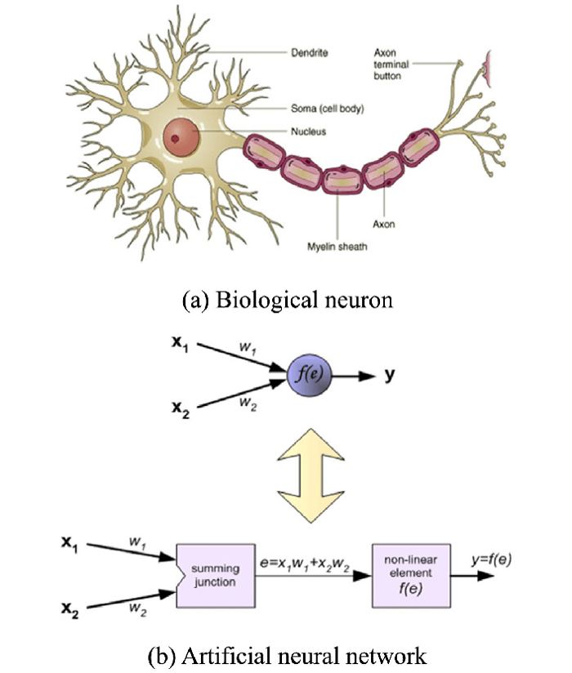
(Artificial) Neural Networks
Perceptron
A weight represent the strength of the connection between units
Output
Inputs/Features
Activation Function
Notes:
The emulation based on the Perceptron will have:
inputs,
weights on the inputs,
If the weight from node 1 to node 2 has greater magnitude, it means that neuron 1 has greater influence over neuron 2
Activation function (to fire or not fire)
An Output

Slide 3
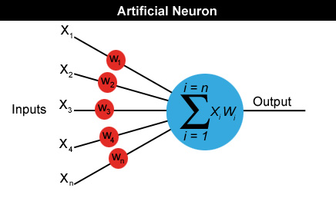
An Artificial Neuron
A neuron can have any number of inputs (features) from 1 to n, where n is the total number of inputs.
The inputs may be represented therefore as x1, x2, x3… xn.
And the corresponding weights for the inputs as w1, w2, w3… wn. (Weights are the theta parameters in Log. Reg)
Output a = x1w1 + x2w2 + x3w3... + xnwn
Features
a = x1w1 + x2w2 + x3w3... + xnwn
3
Notes:
The inputs to the Neural Network represent the features
The corresponding weights are multiplied by the inputs and summed by the artificial neuron
Weights are employed to show how important some inputs are to be processed.

Slide 4
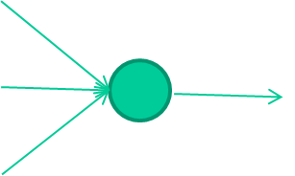
The Output
-0.06
W₁
W₂
f(x)
-2.5
W₃
1.4
What is the output of the Neuron?
4
Notes:
Here is a simple example of an Artificial Neuron with 3 inputs each with a weight.

Slide 5
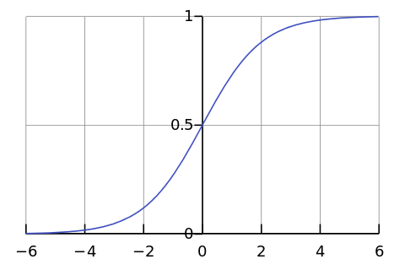

The Output
-0.06
What other roles do activation functions play?
2.7
-8.6
f(x)
-2.5
0.002
x = -0.06×2.7 + 2.5×8.6 + 1.4×0.002 = 21.34
1.4
Activation function will tend to limit the range
5
Notes:
What is the output if an activation function is used?
The output will be any value
But the activation function will tend to limit the range to be between 0 and 1 or 1 and -1

Slide 6
SIGMOID FUNCTION

Slide 7
Activation Function
ANNs are biologically inspired by the activity in our brain, where different neurons fire, or are activated, by different stimuli.
An activation function of a neuron defines the output of that neuron given a set of inputs.
The activation function transforms the sum between a number of lower limit and upper limit.
There are many activation functions that can be used in Artificial Neural Networks (Shallow or Deep) and each plays a different role during learning.
Activation functions include:
Step Functions, Linear Functions,
Sigmoid Functions, Tanh Functions,
Relu/Leaky Relu Function, …..
7
Notes:
Activation function transforms the weighted sum of inputs to a value of lower limit and upper limit.
The choice of activation function has a large impact on the capability and performance of the neural network,
and different activation functions may be used in different parts of the model.
We will cover activation functions in more detail later on and learn what role they play in learning

Slide 8
Perceptron
Notes:
A Perceptron or Neuron or Node or Threshold Logic Unit (TLU) all mean the same thing.

Slide 9
Threshold Logic Unit
A Perceptron or Threshold Logic Unit (TLU) consists of a single Neuron with inputs, weights, activation function and output.
A Single Layer Perceptron – is the simplest feedforward neural network type and does not contain any hidden layer.
inputs
weights
x₁
w₁
output
w₂
activation
x₂
Σ
y
.
.
.
n
θ
a=Σ_{i=1} w_{i} x_{i}
w_{n}
x_{n}
1 if a ≥ θ
y=
0 if a < θ
{
9
Notes:
The single neuron we earlier introduced is called a perceptron or a Threshold Logic Unit
This is the simplest feedforward Artificial Neural Network that has:
inputs and
an output
but no hidden layers
Even though it is simple, yet it is capable of performing some interesting tasks
https://www.youtube.com/watch?v=du5fyS44DR8

Slide 10
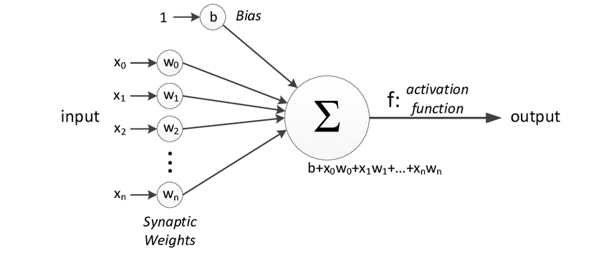
Single Layer Perceptron
The weights show the strength of a particular node. They determine the slope of the line that is used for separating the two classes.
Bias allows you to shift the activation function up or down.
The activation function is important for an ANN to learn and make sense of something really complicated.
The activation function decides whether a neuron should be activated or not by calculating weighted sum and further adding bias to it.
The motive is to introduce non-linearity into the output of a neuron.
10
Notes:
The Perceptron is usually used to classify the data into two parts.
Therefore, it is also known as a Linear Binary Classifier.
The motivation of the Activation Function is to introduce non-linearity.

Slide 11
Sinlge Layer Perceptron
The weights determine the slope of the line that is used for separating the two classes.
Bias allows to shift the activation function up or down.
Output = b + x₀w₀ +x₁w₁ + x₂w₂ + x₃w₃... + x_{n}w_{n}
11
Notes:
A Perceptron is a linear Machine Learning algorithm used for supervised learning for various binary classifiers.

Slide 12
Perceptron Learning
Notes:
What learning algorithm does the perceptron use?
https://www.youtube.com/watch?v=KKSCmPUyczU

Slide 13
Activation Functions
Notes:
An activation function in a neural network:
defines how the weighted sum of the input is transformed into an output from a node or nodes in a layer of the network.
https://medium.com/@himanshuxd/activation-functions-sigmoid-relu-leaky-relu-and-softmax-basics-for-neural-networks-and-deep-8d9c70eed91e

Slide 14

Activation Functions
ANNs calculate a “weighted sum” of its input, adds a bias and then decide whether it should be “fired” or “not fired”
The value of Y can be anything from –inf to +inf.
The neuron doesn’t know the bounds of the value.
So how do we decide whether the neuron should fire or not?
Activation functions
14
Notes:
An activation function in a neural network defines how the weighted sum of the input is transformed into an output from a node or nodes in a layer of the network.

Slide 15
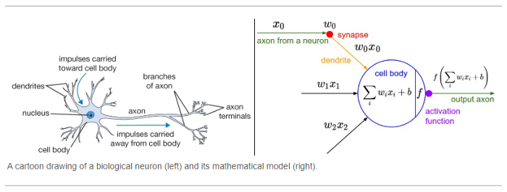
Activation Functions
An activation function is a function that is added into an artificial neural network to help the network learn complex patterns in the data.
When comparing with a neuron-based model that is in our brains, the activation function is at the end deciding what is to be fired to the next neuron.
That is exactly what an activation function does in an ANN as well. It takes in the output signal from the previous cell and converts it into some form that can be taken as input to the next cell.
Notes:
Why there is a need for an Activation Function?
The activation function is important for an ANN to learn and make sense of something really complicated.
Activation function can produce 0 to 1 output or -1 to 1 or any output value that the next neuron can utilize

Slide 16
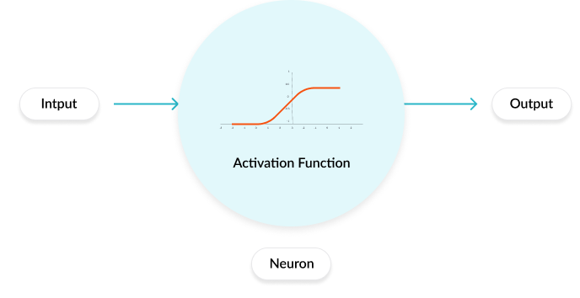
Artificial Neural Networks
ANNs calculate a “weighted sum” of its input, adds a bias and then decide whether it should be “fired” or not
To normalize this range of values, we use Activation Functions to make the whole process statistically balanced.
Helps keep the computation in an ANN bounded and stable
Different types of activation
Functions exist in an ANN
depending on the layer and task
16
Notes:
An activation function is a very important feature of an artificial neural network.
It basically decides whether the neuron should be activated or not.
In artificial neural networks, the activation function defines the output of that node given an input or set of inputs.
Helps keep the computation in an ANN bounded and stable

Slide 17
Activation Functions
Full list: https://en.wikipedia.org/wiki/Activation_function
threshold
linear
y
y
a
a
piece-wise linear
sigmoid
y
y
a
a
17
Notes:
Simply put, an activation function is a function that is added into an artificial neural network in order to help the network learn complex patterns in the data

Slide 18
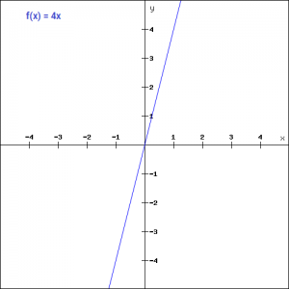
Activation: Linear
Ideal for Regression Problems
In the linear activation function, the output is proportional to the input
f(x)=ax
The gradient here does not become zero.
Linear functions might be ideal for simple tasks where interpretability is highly desired.
However, there are certain drawbacks
Since the gradient is a constant the weights and biases will be updated during the backpropagation process but the updating factor would be the same.!!
18
Notes:
In the linear activation function, the output is proportional to the input
Apart from that, the linear activation function has its set of disadvantages such as:
We observe that the function's derivative is a constant.
That means there is constant gradient descent occurring since there is no relation to the value of z.

Slide 19
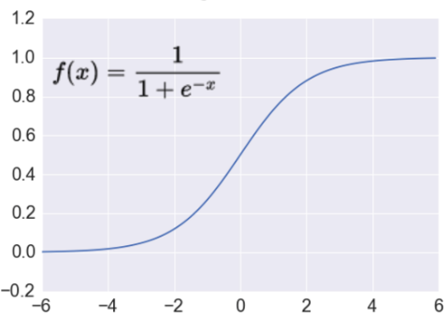

Activation: Sigmoid
Ideal for Binary Classification
Takes a real-valued number and “squashes” it into range between 0 and 1.
$$R^{n}→\left[0,1\right]$$
Also called Logistic function
http://adilmoujahid.com/images/activation.png
Gives a smooth gradient while converging
Nice interpretation as the firing rate of a neuron
Sigmoid is very popular in classification problems.
0 = not firing at all
1 = fully firing
Sigmoid neurons saturate and kill gradients, thus NN will barely learn
when the neuron’s activation are 0 or 1 (saturate)
gradient at these regions almost zero → Vanishing gradient
almost no signal will flow to its weights
if initial weights are too large then most neurons would saturate
OK to use on last layer
19
Notes:
Normally used as the output of a binary probabilistic function.
Advantages:
Gives you a smooth gradient while converging
Gives a clear prediction(classification) with 1 & 0.
Disadvantages:
Prone to Vanishing Gradient problem
Computationally expensive function(exponential in nature).

Slide 20
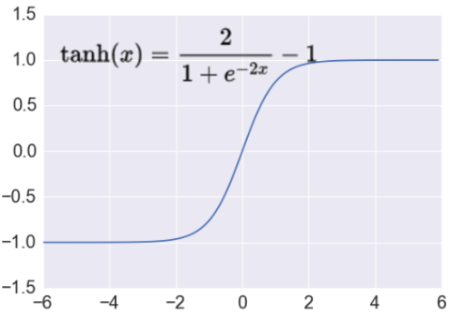

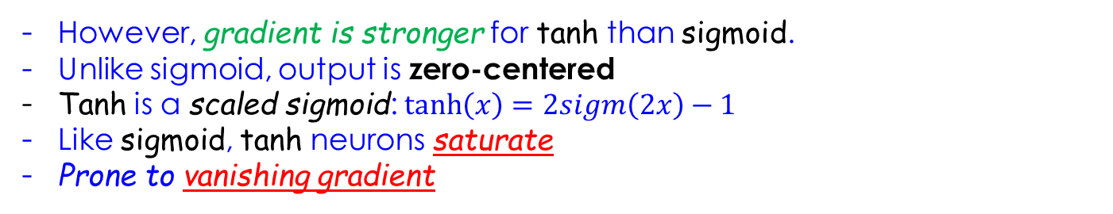

Activation: Tanh
Takes a real-valued number and “squashes” it into range between -1 and 1.
$$R^{n}→\left[−1,1\right]$$
http://adilmoujahid.com/images/activation.png
However, gradient is stronger for tanh than sigmoid.
Unlike sigmoid, output is zero-centered
Tanh is a scaled sigmoid: $\tanh\left(x\right)=2sigm\left(2x\right)−1$
Like sigmoid, tanh neurons saturate
Prone to vanishing gradient
20
Notes:
Advantages:
Zero-centric function unlike Sigmoid.
It is a smooth gradient converging function.
Disadvantages:
Prone to Vanishing Gradient function.
Computationally expensive function(exponential in nature).

Slide 21
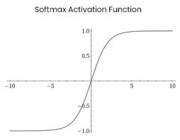
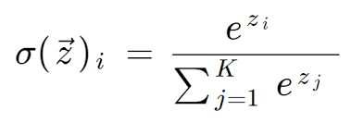
Activation: SoftMax
Converts a vector of numbers into a vector of probabilities.
Ideal for Multi Class Classification
Used extensively for classification tasks
Can be thought of as a softened version of the argmax function that returns the index of the largest value in a list.
The term softmax is used because this activation function represents a smooth version of the winner-takes-all activation model in which the unit with the largest input as output +1 while all other units have output 0
https://machinelearningmastery.com/softmax-activation-function-with-python/
21
Notes:
Softmax is a very interesting activation function because:
it not only maps our output to a [0,1] range but
also maps each output in such a way that the total sum is 1.
The output of Softmax is therefore a probability distribution.
Normally used as the output in multi-class classification problems to find out different probabilities for different classes
(Unlike Sigmoid which is preferred for a binary-class classification).
Sigmoid vs Softmax
https://www.youtube.com/watch?v=dmngpQv5D9Y
https://www.youtube.com/watch?v=vdXpShCJE1M

Slide 22
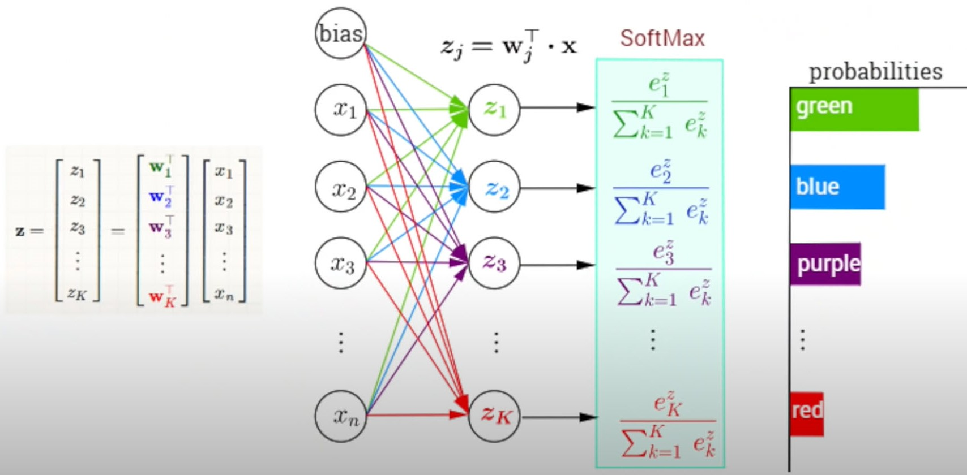
Activation: SoftMax
Maps each output in such a way that the total sum is 1.
Ideal for Multi Class Classification
22
Notes:
The softmax function is often used in the final layer of a neural network-based classifier.
It not only maps our output to a [0,1] range but also maps each output in such a way that the total sum is 1.
Such networks are commonly trained under a log loss (or cross-entropy) regime, giving a non-linear variant of multinomial logistic regression.
not zero-centered: later layers of processing would be receiving data that is not zero-centered.
if data coming into a neuron is always positive then the gradient on the weights will be either all be positive, or all negative (depending on the gradient of the whole expression).
Could introduce undesirable zig-zagging dynamics in the gradient weight updates.
However, once these gradients are added up across a data batch the final weight update can have variable signs, somewhat mitigating this issue.

Slide 23
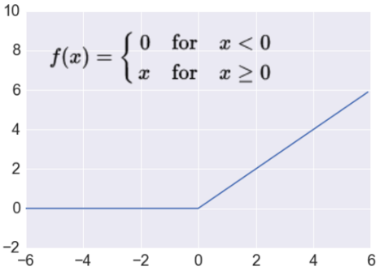


Activation: ReLU
Takes a real-valued number and thresholds it at zero
$$f\left(x\right)= max⁡(0,x)$$
$$R^{n}→R_{+}^{n}$$
Rectified Linear Unit
Most Deep Networks use ReLU nowadays
Trains much faster
accelerates the convergence of SGD
due to linear, non-saturating form
Less expensive operations
compared to sigmoid/tanh (exponentials etc.)
implemented by simply thresholding a matrix at zero
More expressive
Prevents the gradient vanishing problem
Used in the Hidden Layers
23
Notes:
Advantage:
Hinton: Allows Neuron to express a strong opinion (unlike tanh, sigmoid)
Gradient does not saturate (on the high end)
Can deal with Vanishing Gradient problem.
Less sensitive to random initialization
Runs great on low precision hardware
Computationally inexpensive function(linear in nature).
Disadvantage:
ReLU units can “die”
large gradient flowing through a ReLU could cause weights to update in such a way that the neuron will never activate on any datapoint again gradient flowing through the unit will forever be zero from that point on
With a proper setting of the learning rate this is less frequently an issue
Not a zero-centric function.
Gives zero value as inactive in the negative axis.
Some of the ReLU variants include : Softplus (SmoothReLU), Noisy ReLU, Leaky ReLU, Parametric ReLU and ExponentialReLU (ELU).

Slide 24
Activation Functions

Slide 25
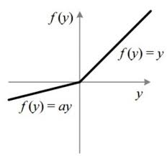
Activation: Leaky ReLU
An improved version of the ReLU activation function
$$R^{n}→R_{+}^{n}$$
Leaky Rectified Linear Unit
Some Deep Networks use Leaky ReLU nowadays
ReLU activation function, the gradient is 0 for all the values of inputs that are less than zero, which would deactivate the neurons in that region and may cause dying ReLU problem
Leaky ReLU is defined to address this problem.
25
Notes:
It is the same as of RELU function except it gives some partial value(0.01 instead zero as of RELU) in the negative axis.

Slide 26
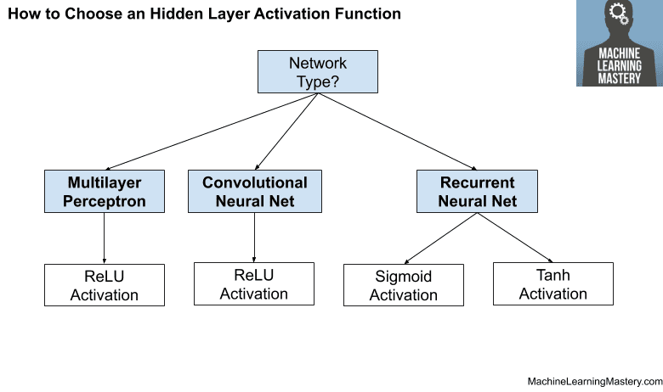
How to Choose Activation Fn.
Hidden Layer
A Neural Network will almost always have the same function in all hidden layers.
Traditionally, the Sigmoid activation function was the default activation function in the 1990s.
Through the mid to late 1990s to 2010s, the Tanh function was the default activation function for hidden layers.
Modern neural network models with common architectures, such as MLP and CNN, will make use of the ReLU activation function, or extensions.
26
Notes:
the hyperbolic tangent activation function typically performs better than the logistic sigmoid.

Slide 27
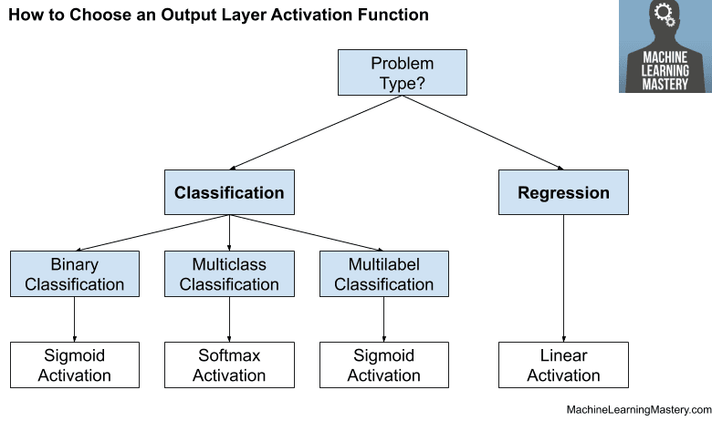
How to Choose Activation Fn.
Output Layer
Data Scientists must choose the activation function for their output layer based on the type of prediction problem that they are solving.
If a Regression problem is being solved then a linear activation
For Binary Classification use a Sigmoid Activation
For Multiclass Classification use a Softmax Activation
For Multilabel Classification use 1 node per class Sigmoid Activation
27
Notes:
the hyperbolic tangent activation function typically performs better than the logistic sigmoid.

Slide 28
Multi-Layer Perceptron (MLP)
Notes:
The term MLP is used loosely to mean any feedforward ANN, sometimes strictly to refer to networks composed of multiple layers of Perceptrons;

Slide 29
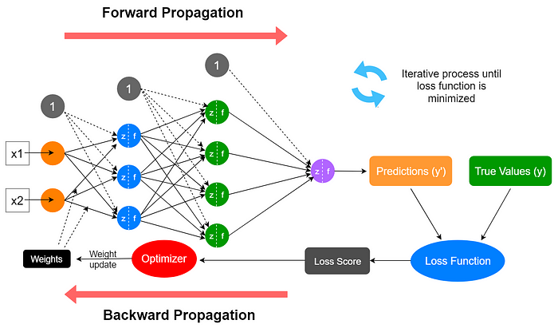

Slide 30
Neural Networks
Networks of processing units (neurons) with connections (synapses) between them.
Large number of neurons: 10¹⁰
Large connectitivity: 10¹²
Advantages:
Parallel processing as apposed to Sequential.
Distributed computation/memory
Robust to noise, failures (fault tolerant)
Capable of achieving complex tasks.
30
Notes:
While we understand what a single neuron can do and achieve (in terms of computation)
The power of the brain in humans and mammals is based on a large number of neurons (billions) and connections
Researchers are motivated to emulate Biological Neurons and create Artificial Neural networks to achieve:
Robustness, capability to solve hard/complex problems,
ANNs will lend themselves naturally to parallel processing

Slide 31

A Simple Neural Network
A Multi Layer Perceptron has one or more hidden layers.
While single layer perceptron can only learn linear functions, a multi layer perceptron can also learn non-linear functions.
Weights
Input
Hidden Layer
Output
W₁₁
x1
W₁₂
a1⁽¹⁾
W₁₄
W₁₃
x2
a2⁽¹⁾
a1⁽²⁾
Y
x3
a3⁽¹⁾
x4
a4⁽¹⁾
The objective of the neural network is to transform the inputs (features) into meaningful outputs that match labels available.
31
Notes:
A Shallow ANN is composed of several Neurons and not only one Perceptron
An ANN is composed of several layers, Input, Hidden, Output
Shallow ANNs with 1-2 hidden layers (unlike Deep ANNs) are capable of learning non-linear functions as opposed to a simple perceptron

Slide 32
Properties of Architecture
No connections within a layer
No direct connections between input and output layers
Fully connected between layers
Often more than 3 layers
# of output units need to equal number of classes!
# of hidden units per layer can be more or less than I/O units
Each unit is a perceptron
Often include bias as an extra weight
32
Notes:
The main properties of an ANN Architecture can be summarized in the following
No connection between neurons in the same layer
Inputs and Outputs are connected via a hidden layer
Neurons in one layer are fully connected to neurons in the next layer
Weights are randomly generated.
If we have a binary classification problem, we will have 2 output units (one for each class)

Slide 33
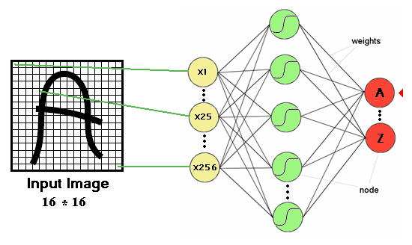
Multi-layer Perceptron and image processing
Artificial Neural Networks have been used extensively to classify images.
Each input represent a pixel of an image.
For a large image (200x200) we would need 40,000 inputs!!
26 Outputs
256 Pixels
33
Notes:
Here is an example of where an ANN can be used to classify images
Each pixel would be an input.
The total number of inputs is 256
The outputs of the ANN correspond to the # of classes

Slide 34

Number of Parameters
x1
a1⁽¹⁾
x2
a2⁽¹⁾
a1⁽²⁾
Y
x3
a3⁽¹⁾
Softmax
x4
a4⁽¹⁾
Input
Hidden Layers
Output
The total number of parameters to be learnt:
4*4 + 4 +1
= 21
34
Notes:
Given the following architecture with a single hidden layer (4 neurons) and an output with a single neuron
The total number of parameters = 21.

Slide 35

If the input is an Image?
RGB
x1
a1⁽¹⁾
x2
a2⁽¹⁾
a1⁽²⁾
Y
x3
a3⁽¹⁾
400 X 400 X 3
a480000⁽¹⁾
x480000
Input
Hidden Layers
Output
Number of Parameters
480000*480000 + 480000 +1 = approximately 230 Billion !!!
If we limit the number of neurons in hidden layer to say 1000
480000*1000 + 1000 +1 = approximately 480 million !!!
35
Notes:
If the input is an image 400x400x3 (RGB)
The total number of parameters will be almost 480 million
This is a huge number of parameters to be optimized!!

Slide 36
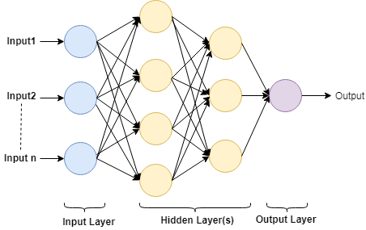
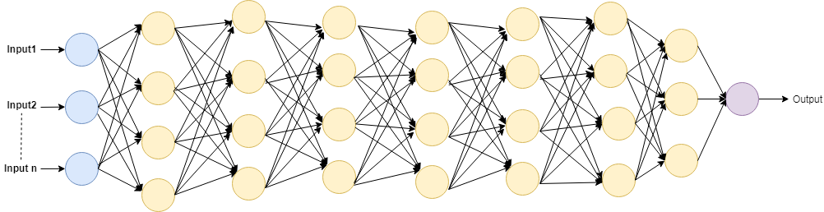
Deep Learning Overview
Deep learning is a subset of machine learning, it refers to having many layers in a neural networks.
It is able to process high dimensional data (Images)
For instance, it can process an image and generate a meaningful response depending on the application.
Deep networks can extract features from data .. An advantage over shallow networks.
Shallow network
Deep network
36
Notes:
Deep learning is a subset of machine learning, which is essentially a neural network with three or more layers.
These neural networks attempt to simulate the behavior of the human brain—albeit far from matching its ability—allowing it to “learn” from large amounts of data
Deep learning is a subfield of machine learning, and neural networks make up the backbone of deep learning algorithms.
In fact, it is the number of node layers, or depth, of neural networks that distinguishes a single neural network from a deep learning algorithm, which must have more than three
Deeper networks are able to create deep representations, at every layer, the network learns a new, more abstract representation of the input. A shallow network has less number of hidden layers

Slide 37
MLP Learning
Notes:
How do Artificial Neural Networks Learn?

Slide 38
How Do Neural Networks Learn?
A Neural network learns by repeatedly considering a set of input values and trying to predict their corresponding output values as accurately as possible.
This is accomplished by iteratively adjusting the weights for all of the nodes in their input layer and the hidden layer(s) with a view toward minimizing overall prediction error.
Each iteration of the learning process proceeds as follows:
Beginning at the input layer, one or more sets of input values is passed through the network, yielding one or more predictions – this is called forward propagation.
The amount of error in the prediction(s) is measured at output layer.
Working backward from the output layer toward the input layer, the neural network uses the error information to adjust the weights in such a way as to reduce the error – this call back propagation.
Weights are updated using the Stochastic Gradient Descent, or one of it many variants.
After all of the weights have been adjusted, the process is repeated using the next set or sets of input values.
38
Notes:
ANNs learn by adjusting the weights of the wires connecting one neuron to another
The adjustment of the weights is a function of the error that results between the prediction and label
Feed forward means that data flows in one direction from input to output layer (forward).
This type of network is trained with the back propagation learning algorithm.

Slide 39
Training ANNs
Notes:
As with all other Machine Learning Methods, fitting a ML algorithm and learning boils down to solving an optimization problem

Slide 40
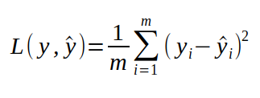
Training Machine Learning
A Loss function is a function that tells us, how good is our neural network for a certain task.
The intuitive way to do it is, take each training example, pass through the network to get the number, subtract it from the label we wanted to get and square it → Mean Square Error (because negative numbers are just as bad as positives).
Where,
y_{i} stands for the actual label,
is the prediction
i is index of a training example.
The above loss function is suitable for what type of task?
40
Notes:
Similar to the exercise we went through for Linear Regression, Logistic Regression,
we propose our Objective Function (Loss Function)
Optimize the Loss Function and find the optimal parameters (find the weights for ANNs)
The above loss function is suitable for regression

Slide 41


Loss functions and output
Classification
Regression
Training
examples
R^{n} x {class_1, ..., class_n}
(one-hot encoding)
R^{n} x R^{m}
Soft-max
[map R^{n} to a probability distribution]
Linear (Identity)
Activation
Function
f(x)=x
Loss
function
Cross-entropy
Mean Squared Error
$$J\left(θ\right)= \frac{1}{n}\sum_{i=1}^{n}{{\left(y^{(i)}−{\hat{y}}^{(i)}\right)}^{2}}$$
$$J\left(θ\right)=−\frac{1}{n}\sum_{i=1}^{n}{\sum_{k=1}^{K}{\left[y_{k}^{(i)}\log{{\hat{y}}_{k}^{(i)}+\left(1−y_{k}^{(i)}\right) }\log\left(1− {\hat{y}}_{k}^{\left(i\right)}\right)\right]}}$$
Mean Absolute Error
$$J\left(θ\right)= \frac{1}{n}\sum_{i=1}^{n}{\left|y^{(i)}−{\hat{y}}^{(i)}\right|}$$
41
Notes:
Classification:
Activation Fn: Softmax can be used for multi class while Sigmoid can be used for Binary Classification
Loss Fn: Cross-entropy can be used as a loss function when optimizing classification models like logistic regression and artificial neural networks.
Regression:
MSE has nice mathematical properties which makes it easier to compute the gradient
Because of the square, large errors have relatively greater influence on MSE.
Therefore, MAE is more robust to outliers since it does not make use of square.

Slide 42
Training Machine Learning
When we start off with our neural network, we initialize our weights randomly. Obviously, it won’t give you good results.
In the process of training, we want to start with a bad performing neural network and wind up with network with high accuracy.
In terms of loss function, we want our loss function to be much lower in the end of training. (Indicates it is learning)
Improving the network is possible, because we can change its “mapping function” by adjusting weights. We want to find another function that performs better than the initial one.
The problem of training is equivalent to the problem of minimizing the loss function.
Why minimize loss?
Reduce the error thus improve prediction capability.
42
Notes:
Very similar to any Machine Learning Algorithm we have encountered so far, training in ANN translates to adjusting weights.
Adjusting weights translates to an optimization problem that seeks to minimize a Loss Function
Is the Loss function in MLPs convex?
https://stats.stackexchange.com/questions/106334/cost-function-of-neural-network-is-non-convex
https://math.stackexchange.com/questions/4402076/how-can-the-loss-functions-of-neural-networks-be-non-convex

Slide 43
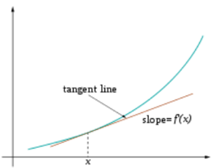
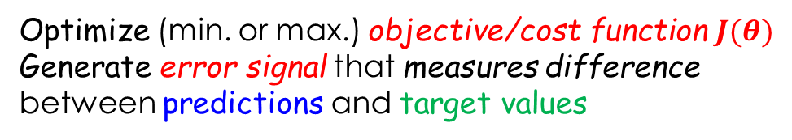
ANN Training
Sample labeled data
(batch)
Forward it through the network, get predictions
Back-propagate the errors
Update the network weights
Optimize (min. or max.) objective/cost function $J(θ)$
Generate error signal that measures difference between predictions and target values
Use error signal to change the weights and get more accurate predictions
Subtracting a fraction of the gradient moves you towards the (local) minimum of the cost function
https://medium.com/@ramrajchandradevan/the-evolution-of-gradient-descend-optimization-algorithm-4106a6702d39
43
Notes:
An error signal that measures the difference between the label and produced prediction is used as a loss function
The Loss function is minimized by calculating the gradient using gradient descent
When do we stop? What is the termination criteria?
No further improvement ..
A certain number of passes
A certain number of epochs

Slide 44
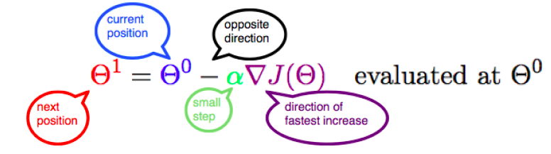
Gradient Descent
Step #1: Take the derivative of the Loss Function for each parameter in it (take the Gradient of the Loss Function)
Step #2: Pick random values for the parameters.
Step #3: Plug the parameter values into the derivatives (Gradient)
Step #4: Calculate the Step Sizes:
Step Size = Gradient x Learning Rate
Step #5: Calculate the New Parameters:
New Parameter = Old Parameter – Step Size
Go to Step #3 (until step size is small or reached max iterations)
44
Notes:
The important steps that need to be taken by the Gradient Descent Algorithm include
Taking the gradient of the Loss Function
Choose a starting point (i.e a random value of the parameter)
Plug in initial starting point in the Gradient
Calculating the Step Size which is determined by the Learning Rate
Recalculating the value of the parameter
Stop if the step size is very small or we reach max iterations

Slide 45
Backpropagation Algorithm
Notes:
Backpropagation algorithm is probably the most fundamental building block in a neural network.
It was first introduced in 1960s
Backpropagation was derived by multiple researchers in the early 60's and implemented to run on computers as early as 1970 by Seppo Linnainmaa.
Paul Werbos was first in the US to propose that it could be used for neural nets after analyzing it in depth in his 1974 dissertation.
Almost 30 years later (1989) popularized by Rumelhart, Hinton and Williams in a paper called “Learning representations by back-propagating errors”.

Slide 46
Backpropagation Alg.
Conceptually:
Forward Activity
Backward Error
Output Response
Forward
Backward
Data
Movement
Error
Propagates
Input Patterns
46
Notes:
Forward Propagation is the way to move from the Input layer (left) to the Output layer (right) in the neural network.
Feed forward means that data flows in one direction from input to output layer (forward).
This type of network is trained with the back propagation learning algorithm.
The process of moving from the right to left i.e backward from the Output to the Input layer is called the Backward Propagation

Slide 47
Backpropagation Alg.
In machine learning, backpropagation is a widely used algorithm for training feedforward neural networks.
In fitting a neural network, backpropagation computes the gradient of the loss function with respect to the weights of the network for a single input–output example, and does so efficiently, unlike a naive direct computation of the gradient with respect to each weight individually.
This efficiency makes it feasible to use gradient methods for training multilayer networks, updating weights to minimize loss; gradient descent, or variants such as stochastic gradient descent, are commonly used.
The backpropagation algorithm works by computing the gradient of the loss function with respect to each weight by the chain rule,
Computing the gradient one layer at a time, iterating backward from the last layer to avoid redundant calculations of intermediate terms in the chain rule.
47
Notes:
The back-propagation learning algorithm computes the mean-squared error of the difference between the desired output and the real output value and adjusts the weight and bias coefficients until the mean-squared error function reaches a predetermined minimum value.

Slide 48
Backpropagation Alg.
1. Initialize network with random weights
2. For all training cases (called examples):
a. Present training inputs to network and calculate output
b. For all layers (starting with output layer, back to input layer):
i. Compare network output with label (error function)
ii. Adapt weights in current layer
48
Notes:
Below are the steps involved in Backpropagation:
Step – 1: Forward Propagation (present all training examples to inputs and values will propagate to the output)
Step – 2: Backward Propagation (compare labels with predictions)
Step – 3: Putting all the values together and calculating the updated weight value.

Slide 49
‘Back-prop’ Algorithm Summary (with NO Math!)
49
Notes:
The weights of artificial neural networks must be initialized to small random numbers.
This is because this is an expectation of the stochastic optimization algorithm used to train the model, called SGD.
Perform a forward pass to produce a network output
For each output unit, compute local gradients
Preform backward pass:
For all hidden units compute gradients
For all weights, change weights by gradient descent

Slide 50
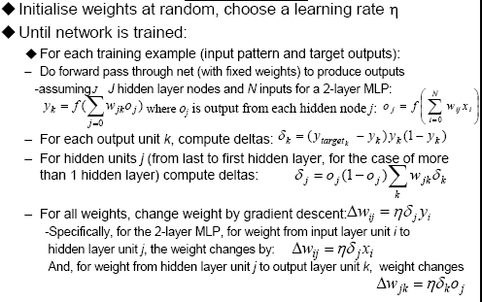
‘Back-prop’: Generalized Delta Rule
50
Notes:
Randomly initialize the weights
Perform the following tasks until the network is trained
Do the forward pass and
calculate the outputs of each hidden neuron in each layer
Do the backward pass:
For each output calculate the deltas
For each hidden unit compute the deltas
For all weights change using the gradient descent
Delta Rule:
https://www.youtube.com/watch?v=dK4veEQnt2I
https://www.youtube.com/watch?v=wvXgjETpDpk

Slide 51
A Worked Example
Notes:
We introduce a worked example and step by step to demonstrate the “Backpropagation” algorithm
Delta Rule
https://www.youtube.com/watch?v=4prQu-PfSG8
https://www.youtube.com/watch?v=U6nA3u1ef1g

Slide 52
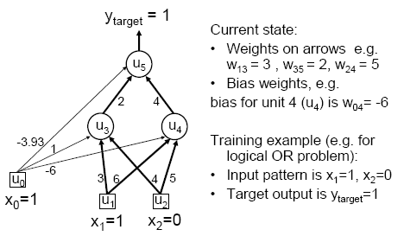
MLP/BP: A Worked Example
Forward Propagation Phase 1, Step #1
Weights
Network Structure
Inputs & Outputs
52
Notes:
Networks Structure:
A network with two inputs, a single hidden layer with two hidden neurons and a output layer with a single neuron
Data:
Weights are as shown on the edges (between inputs and hidden, between hidden and output)
Bias is set to 1 and weights between Bias and hidden/output neurons are shown
Input Data is for a Logical OR operation

Slide 53
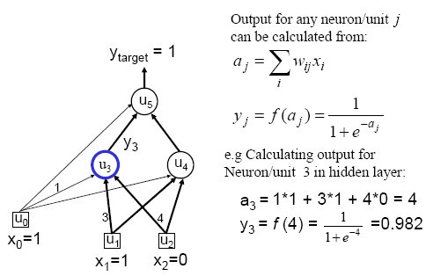
Forward Pass: Outputs
Forward Propagation Phase 1, Step #2
0.982
53
Notes:
The output of (Unit)3 is calculated as:
The weighted sum of the inputs
Applying the activation function (Sigmoid)
The output is calculated as 0.982 and it has to be compared to the label

Slide 54
Forward Pass: Error
Forward Propagation Phase 1, Step #3
54
Notes:
Applying inputs to all the hidden layers and finally the output layer we calculate the output to be 0.51
The error is calculated to be 0.490

Slide 55
Backward Pass: deltas
Backward Propagation Phase 1, Step #1
The delta values computed will be used to adjust the weight values
55
Notes:
Now we start the backward propagation phase apply the delta rule to the output and hidden units
The delta calculated for each unit is the amount by which weights will be updated as we propagate from output back to input

Slide 56
Update Weights: Generalized Delta Rule
Backward Propagation Phase1, Step #2
56
Notes:
In this step we use the gradient descent to update the values of the weights
Given the delta3 and delta5 we calculated earlier we can now update the weights of
Weight₀₃
Weight₁₃

Slide 57
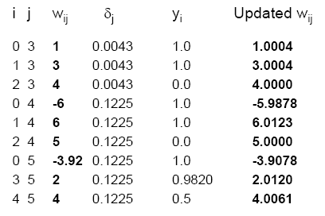
Similarly for all weights w_{ij}:
Backpropagation Algorithm, Phase1 Updates
Weight values are updated and ready for next data records
57
Notes:
The updates weights after Phase 1 of forward and backward propagation

Slide 58
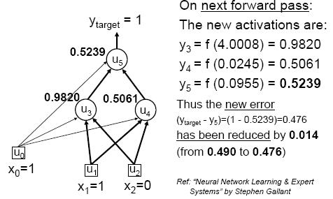
Verification that it works
Forward Propagation Phase 2, Step #1
The error is reduced by 2.8% in one phase
58
Notes:
Once the weights are updated and new inputs are applied the neurons new activations are computed
The difference between the output neuron and label is now 0.476 vs 0.490 (earlier)
We reduced the error by 2.8% in one phase

Slide 59
INTERACTIVE NEURAL NETWORK SIMULATOR
Neural Network Simulator (mladdict.com)

Slide 60
Training & Testing

Slide 61
Training
This was a single iteration of back-propagation
Training requires many iterations with many training examples or epochs
One epoch is entire presentation of complete training set
# of epochs is an important hyper-parameter to tune
It can be slow !
Note that computation in MLP is local (with respect to each neuron)
Parallel computation implementation is also possible
61
Notes:
The number of epochs is the number of complete passes through the training dataset
(one entire transit of the training data through the algorithm is known as an epoch).
The number of epochs is a hyperparameter that defines the number times that the learning algorithm will work through the entire training dataset.

Slide 62
Training and Testing data
How many examples ?
The more the merrier !
Disjoint training and testing data sets
learn from training data but evaluate performance (generalization ability) on unseen test data
Aim: minimize error on test data
62
Notes:
How many samples/Examples?
There's an old rule of thumb for multivariate statistics that recommends a minimum of 10 cases for each independent variable.
Some researchers advise to use a minimum sample size of fifty times the number of weights in the ANN; it should be noted, that the number of weights is generally much larger than the number of parameters in a discrete choice model.

Slide 63
Overfitting
Notes:
One of the problems that occur during neural network training is called overfitting.
The error on the training set is driven to a very small value,
but when new unseen (Testing) data is presented to the network the error is large.
The network has memorized the training examples, but it has not learned to generalize to new situations.

Slide 64
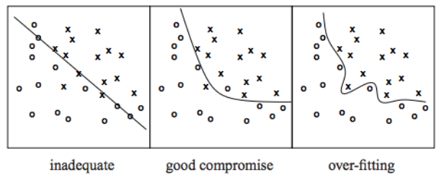
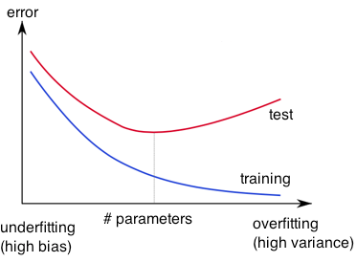
Overfitting
http://wiki.bethanycrane.com/overfitting-of-data
Learned hypothesis may fit the training data very well, even outliers (noise) but fail to generalize to new examples (test data)
How to overcome Overfitting?
https://www.neuraldesigner.com/images/learning/selection_error.svg
64
Notes:
ANNs tend to Overfit!!
In overfitting, the model is memorizing …
It does well in the training data (high accuracy)
However, it fails to generalize and therefore the accuracy of the testing data is low
How to solve Overfitting?
Model Selection
Hyper Parameter Tuning
Train with more Data
Data augmentation
Feature Selection
Early stopping
Regularization
Dropout

Slide 65
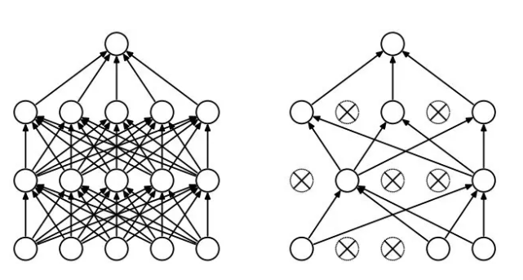
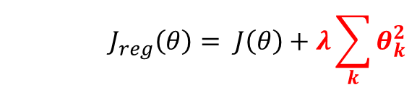
Regularization
Dropout
Randomly drop units (along with their connections) during training
Each unit retained with fixed probability p, independent of other units
Hyper-parameter p to be chosen (tuned)
Srivastava, Nitish, et al. "Dropout: a simple way to prevent neural networks from overfitting." Journal of machine learning research (2014)
L2 = weight decay
Regularization term that penalizes big weights, added to the objective
Weight decay value determines how dominant regularization is during gradient computation
Big weight decay coefficient → big penalty for big weights
$$J_{reg}\left(θ\right)= J\left(θ\right)+λ\sum_{k}{θ_{k}^{2}}$$
Early-stopping
Use validation error to decide when to stop training
Stop when monitored quantity has not improved after n subsequent epochs
n is called patience
65
Notes:
Dropout: is a technique used to prevent a model from overfitting.
Dropout works by randomly setting the outgoing edges of hidden units (neurons that make up hidden layers) to 0 at each update of the training phase.
Dropout is a technique where randomly selected neurons are ignored during training. They are “dropped-out” randomly. This means that their contribution to the activation of downstream neurons is temporally removed on the forward pass and any weight updates are not applied to the neuron on the backward pass.
L1, L2 Regularization: apply a penalty to some parameters to further simplify a model
Early Stopping: In machine learning, early stopping is a form of regularization used to avoid overfitting when training a learner with an iterative method, such as gradient descent.
Such methods update the learner so as to make it better fit the training data with each iteration.
Early stopping is a method that allows you to specify an arbitrary large number of training epochs and stop training once the model performance stops improving on a hold out validation dataset.

Slide 66
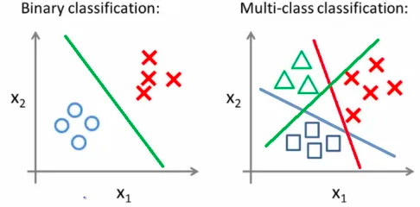
DL PROBLEM

Slide 67
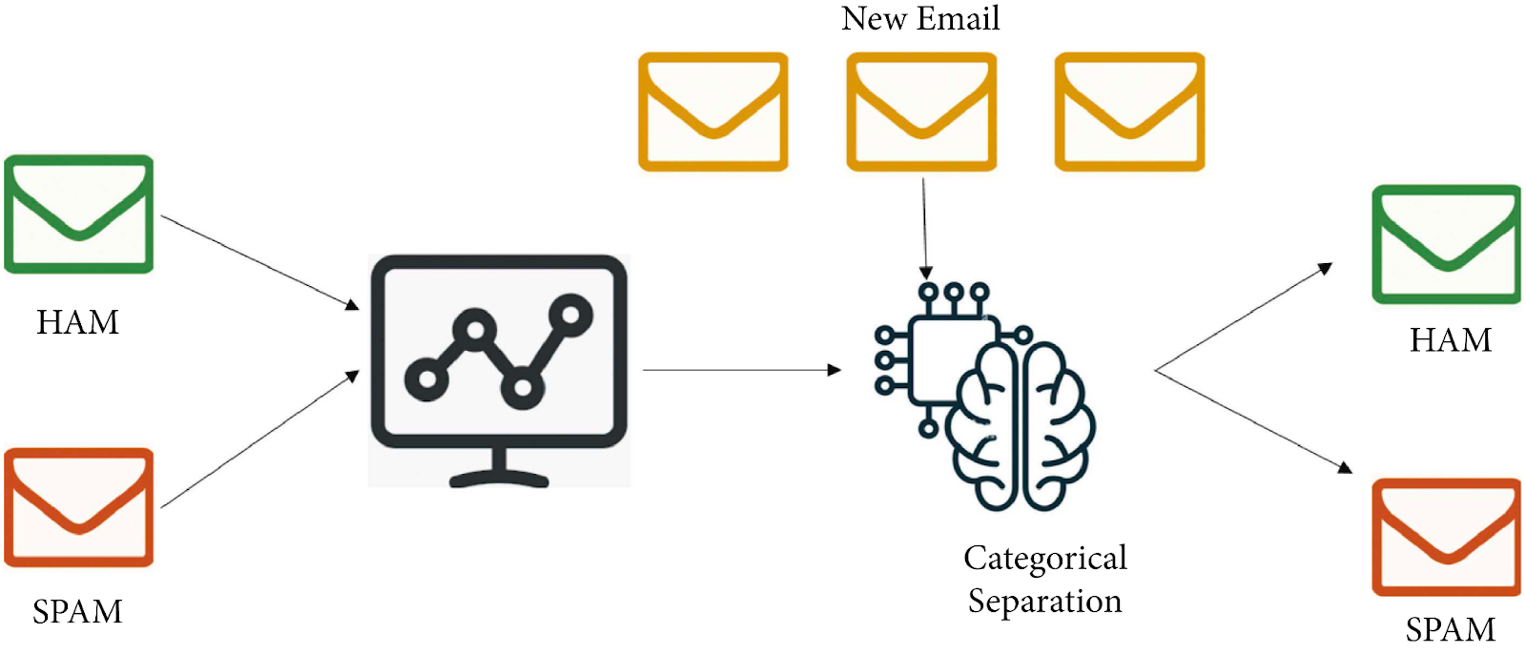
BINARY CLASSIFICATION - EXAMPLE

Slide 68
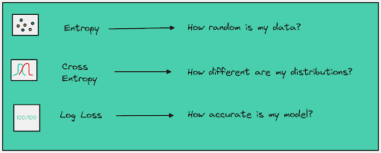
Cross entropy loss
Cross-entropy loss refers to the contrast between two random variables.
It measures the variables to extract the difference in the information they contain, showcasing the results.

Slide 69

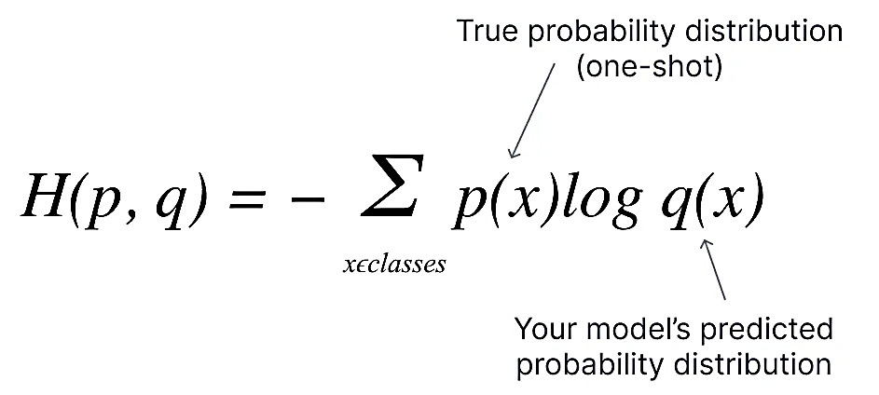
Types
BINARY CROSS ENTROPY LOSS
CATEGORY CROSS ENTROPY LOSS

Slide 70
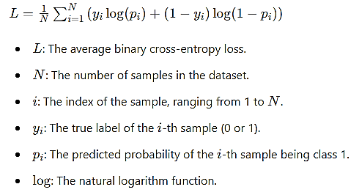
BINARY CROSS ENTROPY LOSS

Slide 71
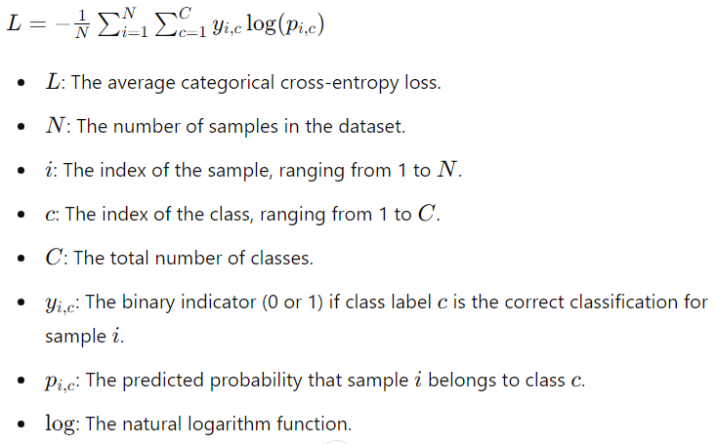
CATEGORY CROSS ENTROPY LOSS

Slide 72
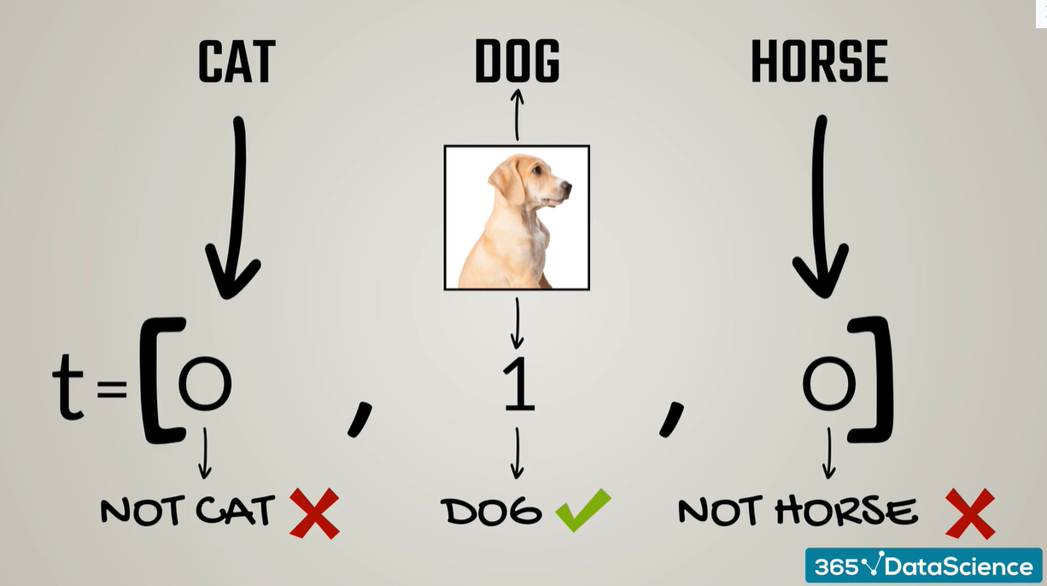

Slide 73
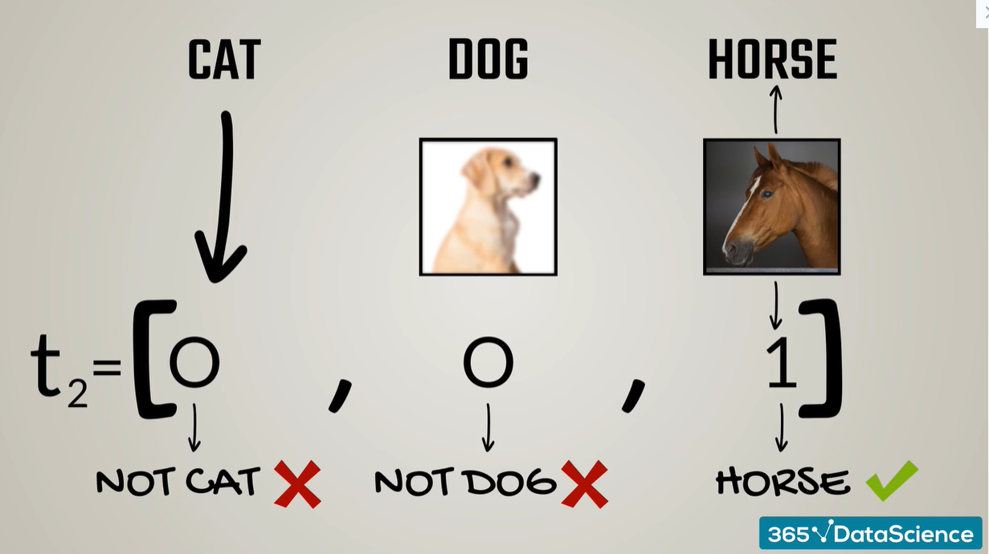

Slide 74
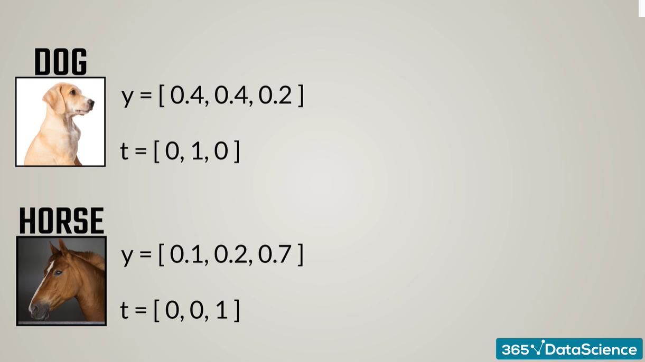

Slide 75
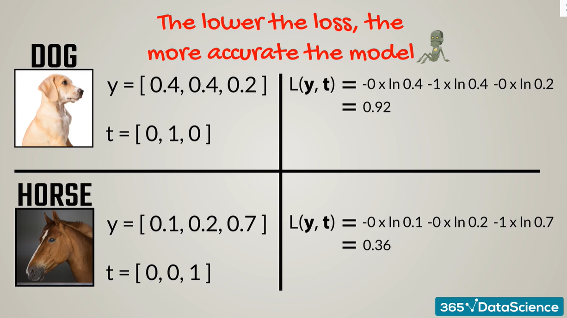

Slide 76
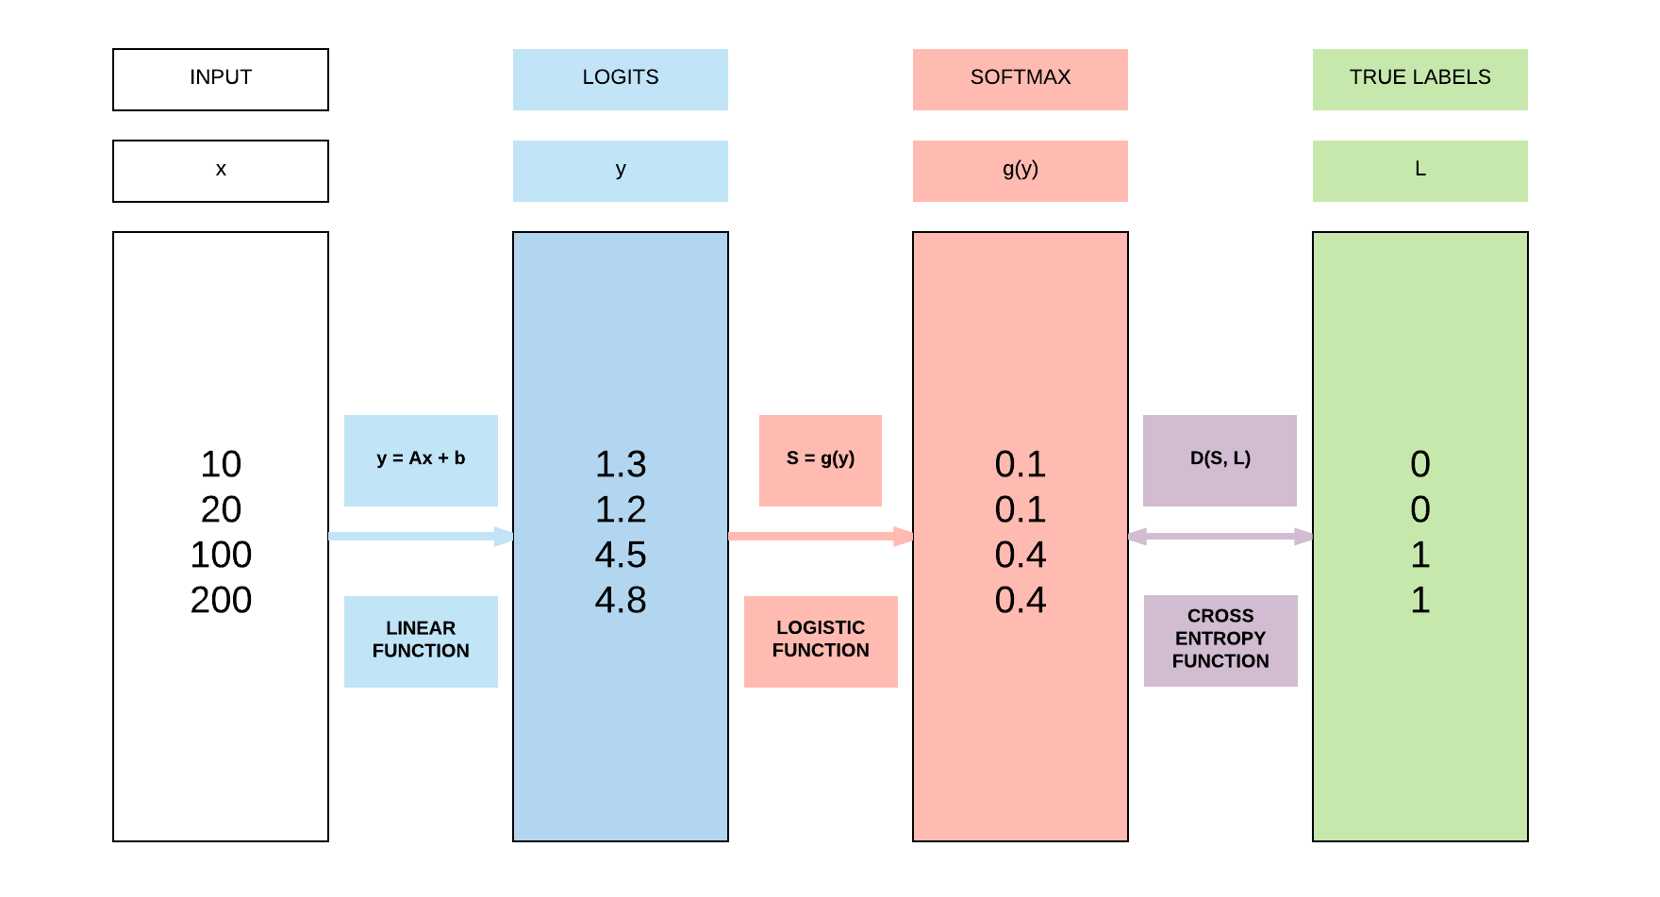

Slide 77
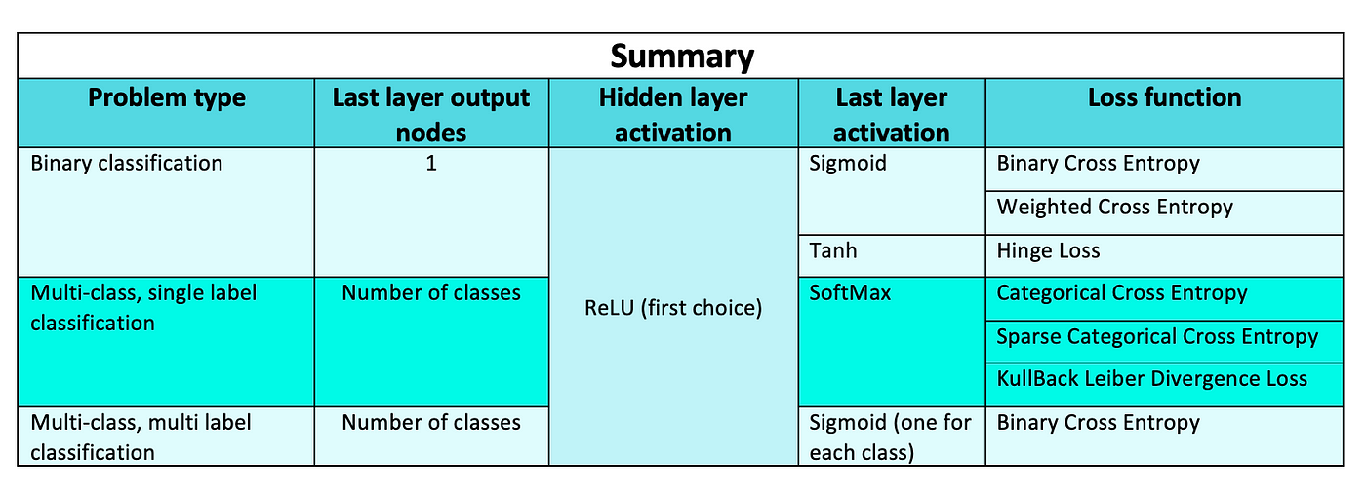
Loss Function - Selection

